Slide 1
Title: Using E-mail to Communicate with Instructor and Peers
Unit: Web CT Orientation Course, Module 2 RLO
RLO Overview:
PowerPoint of process of composing e-mails in Web CT.
Self-Reflection or Journal Questions
Links to Resources on E-mail and Netiquette
“Good or Bad E-mail” activity
Directions for closing (summative ) assignment
Designer: Julie Kling

Slide 2
Web CT Orientation
Module 2
Using E-mail to Communicate
with Instructor and Peers

Slide 3
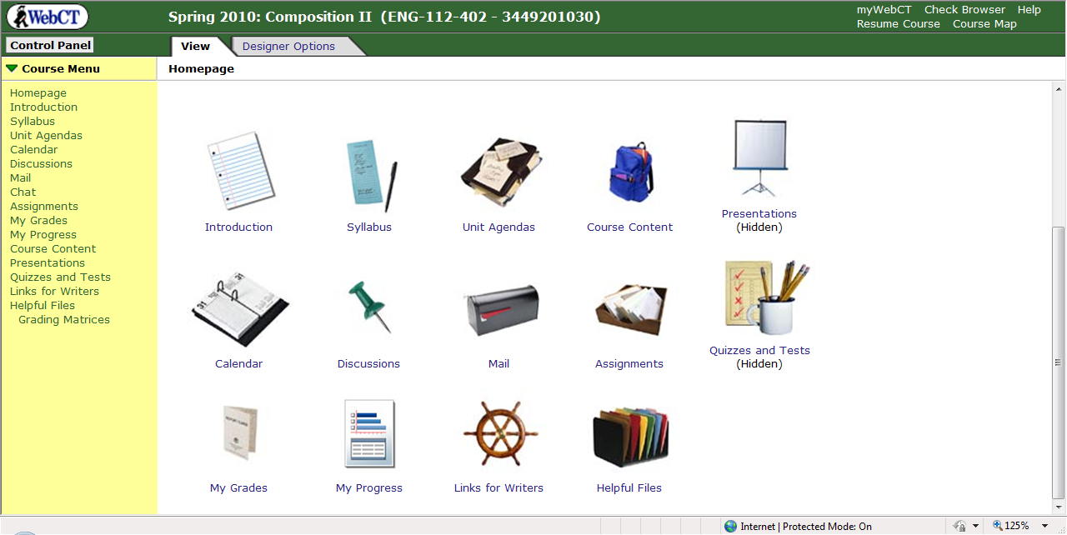
Click on E-mail Icon.

Slide 4
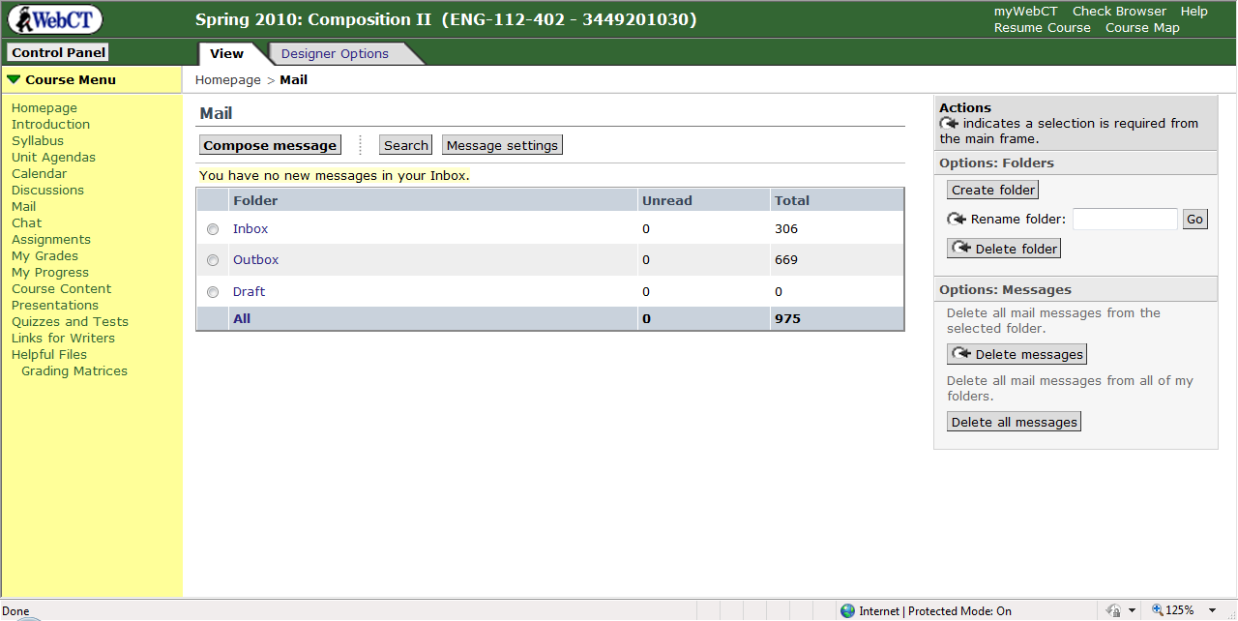
Click on Compose Message

Slide 5
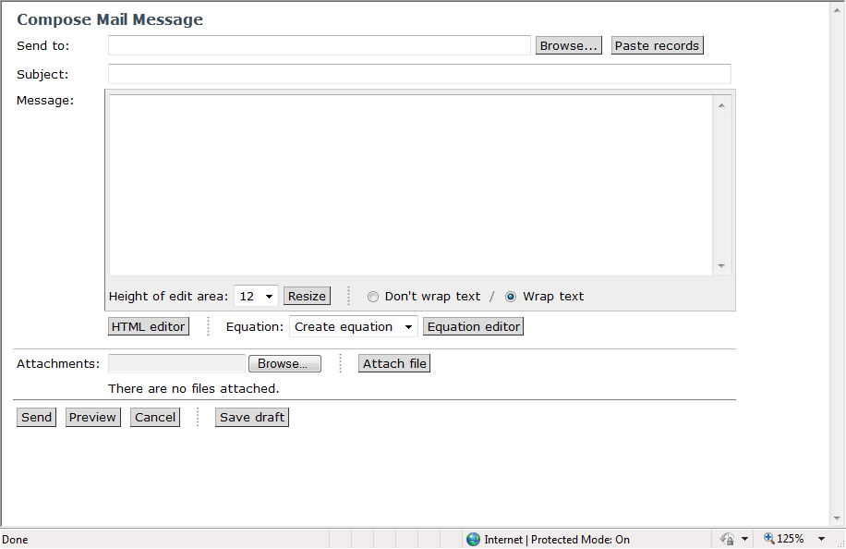
Blank e-mail message opens; click on Browse.

Slide 6
Select Instructor’s Name (or Peer’s Name) from drop down box and make sure it is highlighted.

Slide 7
Click on Select.

Slide 8
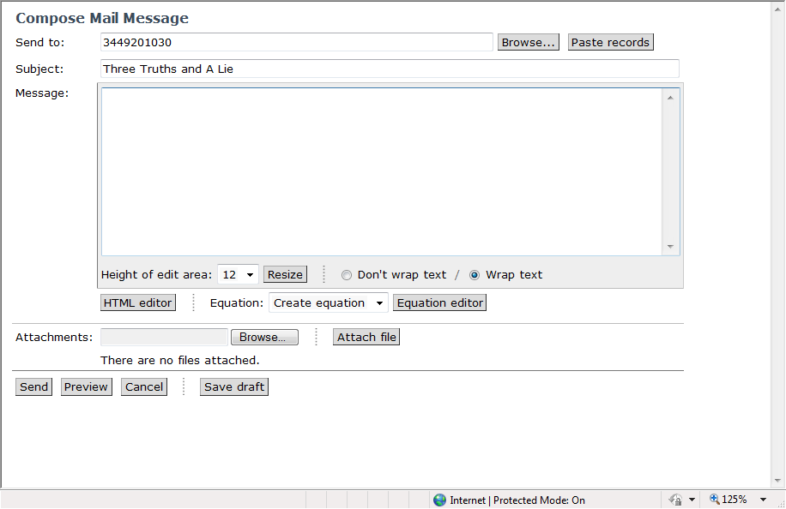
Enter text in the subject line.

Slide 9
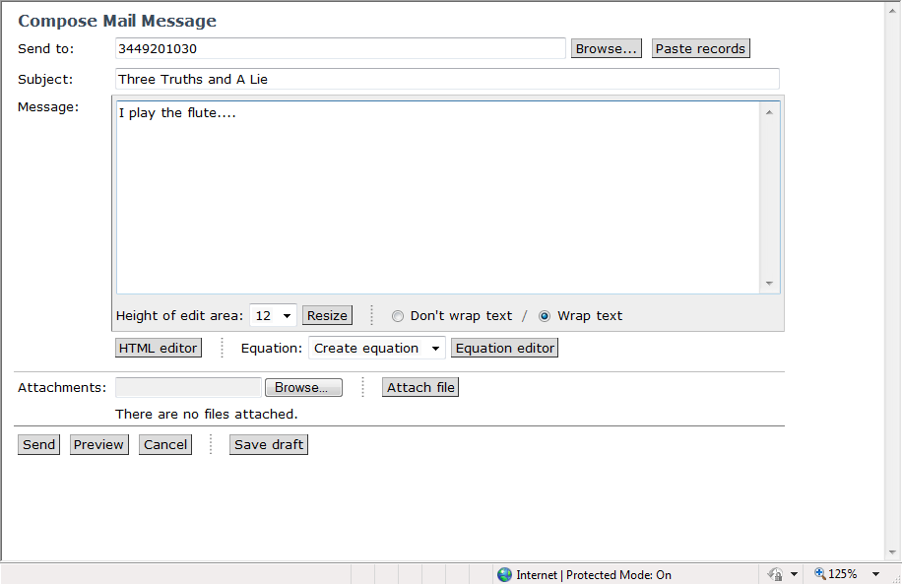
Enter Text in message box.

Slide 10
Click Send.

Slide 11
Follow these steps to send e-mails within Web CT:
Starting at Web CT Course Home Page:
Click on E-mail Icon.
Click on Compose Message.
Blank e-mail opens; click on Browse.
Select Name from drop down menu making sure it is highlighted.
Click Select.
Enter Text in subject line and message box.
Click on Send.

Slide 12
Points to Ponder
How much time, if any, do you spend e-mailing friends/family currently?
Why do you think e-mail is an important mode of communication in an on-line course?”
How do you envision using e-mail in this course or future courses?

Slide 13
Netiquette and E-mail
Visit at least two of the links below to discover some of the “rules” for e-mailing.
http://nursing.wsu.edu/current/netiquette.pdf
http://www.brighthub.com/education/online-learning/articles/26946.aspx
http://students.msbcollege.edu/elearning/netiquette/
http://www.swmich.edu/hybrid/netiquette.php

Slide 14
Good or Bad E-mail
The following slides contain examples of e-mails that students have sent to their professors. Read each one and decide if it is appropriate or not. Then click “good” if you think it is appropriate and “bad” if it is not. Good luck!

Slide 15
Student E-mail #1
Dear Teach:
U no I cant open my files. How do i do that? Need yur help. Fast.
Fredricka
GOOD
BAD

Slide 16
#1: Good
No, Fredricka should not address her professor as “Teach.” She also needs to use complete words rather than abbreviations. U should be “you.” She should also proofread her e-mail. Click on the star below to view the revised version.
Revised E-mail #1

Slide 17
#1: Bad
You are correct! Fredricka should not address her professor as “teach.” She also needs to use complete words rather than abbreviations and proofread. Click on the star below to the revised version.
Revised E-mail #1

Slide 18
Student E-mail #2
Hey:
Got 2 work. Assignments: WHY CAN’T I HAVE MORE TIME? This is two hard.
Emil
GOOD
BAD

Slide 19
#2: Good
No, Emil should not address his professor or anyone as “hey.” Use the person’s name for the greeting. Capital letters indicate shouting in e-mail communication. Emil also means “too” rather than “two.” Click on the star below to view the revised version.
Revised Version #2

Slide 20
#2: Bad
You are correct! Emil should not address his professor as “hey.” Also capital letters indicate shouting. He should proofread his note as well. Click on the star below to view the revised version.
Revised Version #2

Slide 21
Student E-mail #3
Dear Kling:
What date does course end? When grades posted day what?
Hercules
GOOD
BAD

Slide 22
#3: Good
No, Hercules needs to include his professor’s title. He also needs to revise the wording of his questions so it is clearer. Click the star below to see a revised version of Hercules’ note.
Revised Version #3

Slide 23
#3: Bad
You are correct! Hercules needs to include his professor’s title and also revise the wording of his note. Click the star below to see revised version of Hercules’ note.
Revised Version #3

Slide 24
Revised E-mail #1
Dear Professor Kling:
I want you to know that I can’t open my files. How do I do that? I need your help as soon as possible. Thank you, Fredricka
Click here to go to E-mail #2

Slide 25
Revised E-mail #2
Professor Kling:
I have to work. May I have more time on my assignments? This is too hard.
Emil
Note: Emil also might want to include what he is finding difficult so the instructor can further assist him.
Click here to go to E-mail #3

Slide 26
Revised E-mail #3
Dear Professor Kling:
What date does the course end? When are final grades posted?
Hercules

Slide 27
Connect activity/Summative Assessment:
In this module, you have learned how to e-mail your instructor and your peers and considered the role of e-mail in online learning. Considering your reflections and experiences in this module, prepare and send a two paragraph Web CT e-mail to your instructor that discusses your experience using e-mail and your expectations for the role e-mail will play in online learning. Remember to use good English grammar and appropriate language.

Slide 28
Assessment Rubric:
Students will receive points for submitting this assignment on time and for completing it successfully.
Grading rubric: 5-Assignment was completed on time and the student has communicated effectively in a two paragraph e-mail his/her expectations and/or experience using e-mail. Good grammar and appropriate language is used.
4-Assignment was completed on time but the student has only partially communicated his/her expectations or experience using e-mail. Response needs developed. Good grammar and appropriate language is generally used.
3-Assignment was completed on time and only partially communicates the students experience and/or expectations for the use of e-mail in online learning. Contains some significant errors in grammar or language usage.
2-Assignment is late, contains major errors in grammar and language usage, or is severely incomplete.
1-Assignment is late, contains major errors in grammar and language usage, and is incomplete.

Slide 29
Congratulations: You are now ready to send e-mails!
To review Powerpoint: Click here.
To review Netiquette links: Click here.
To review “Good and Bad” e-mails: Click here.

